Slide 1
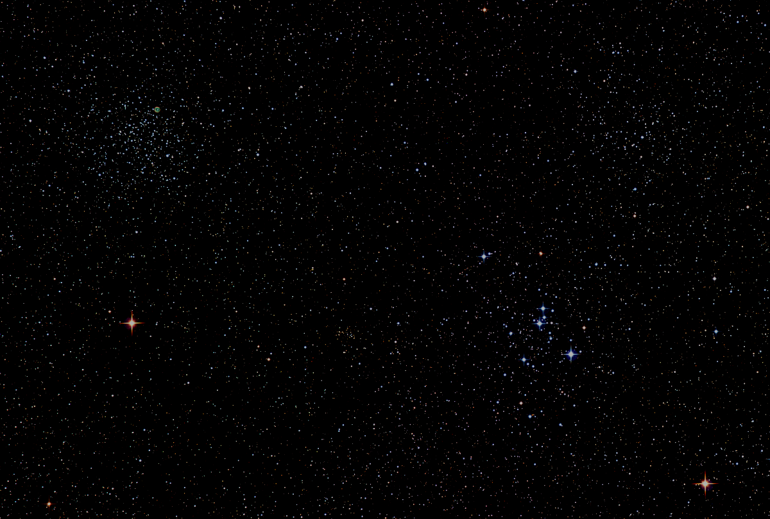

Howard
Astronomical
League
17
July 20th, 2017

Slide 2
Introductions

Slide 3
HAL Social Media
Website: https://www.howardastro.org
Facebook:
https://www.facebook.com/groups/howardastro/
To Access Yahoo Group (mailing list):
https://groups.yahoo.com/neo/groups/howardastro/info
To Join Howardastro Send Blank E-mail to:
howardastro-subscribe@yahoogroups.com
To Leave Howardastro Send Blank E-mail to:
howardastro-unsubscribe@yahoogroups.com
Notes:
The HAL website averages 3800 unique visitors each month. The HAL Yahoo group has 378 members and the Facebook group has 312 members. Current HAL membership is 243.

Slide 4
Upcoming Events
HAL Star Party Events at Alpha Ridge Park
July 22th at 8:30pm - Members Star Party (David Stein)
  Any CTO/CTA Free to Use Watson for Practice
July 29th at 7PM - Celestial Searchers Star-B-Q
  Open to HAL Members. Check howardastro yahoogroup emails from Joel
July 29th at 8:30pm - Public Star Party (Ed Crawford)
  Jim Johnson / Ken Everhart (CTOCTA)
Regional Events
Now - Stellafane & Greenbank Star Quest (ends Sunday)
Tomorrow - Almost Heaven Star Party (ends Tuesday)
Sept. 22-24 – Black Forest Star Party

Slide 5
Guest Speaker
Dr. Roopesh Ojha
NASA Astrophysicist
Astronomy on Ice
Notes:
Dr Roopesh Ojha is an astronomer working at NASA's Goddard Space Flight Center in Greenbelt, MD. His current work is focused on supporting the Fermi Gamma-ray Space Telescope and conducting multiwavelength and multi-messenger observations of active galactic nuclei. After completing a thesis that developed and used the technique of very long baseline polarimetry to study blazars, he has worked on submillimeter studies of Giant Molecular Clouds, the nature of interstellar scintillation and improving the International Celestial Reference Frame among other interests. Dr Ojha is very fond of sharing his attempts to understand the tiny bits of the cosmos his work brings him in contact with both formally and informally and he is really looking forward to interacting with you tonight.

Slide 6
Member’s astrophotos
and sketches

Slide 7
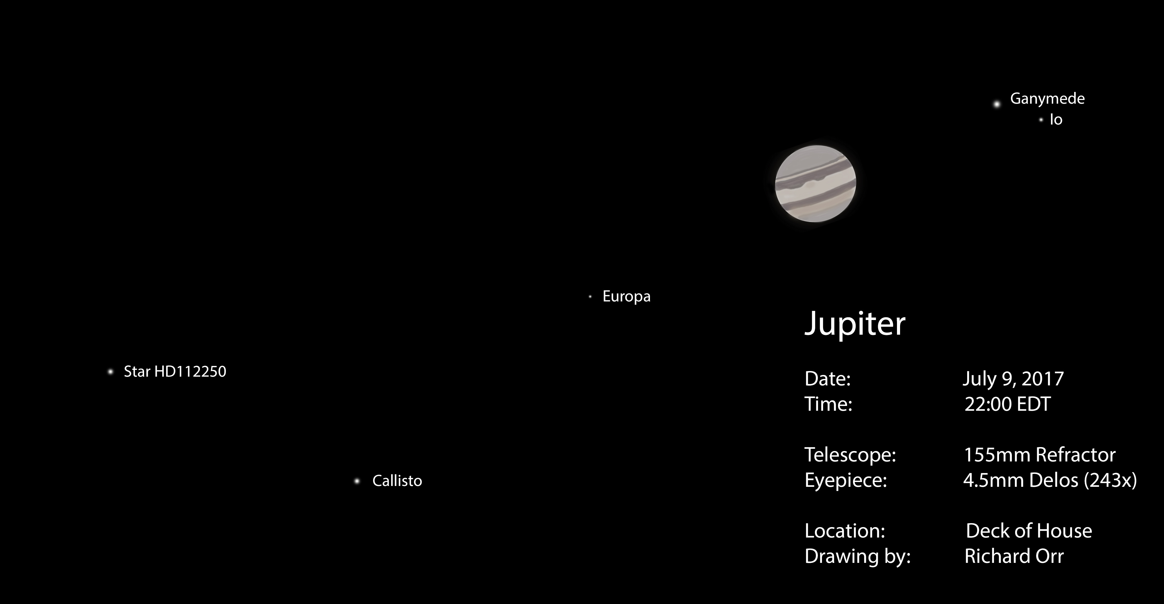

Slide 8
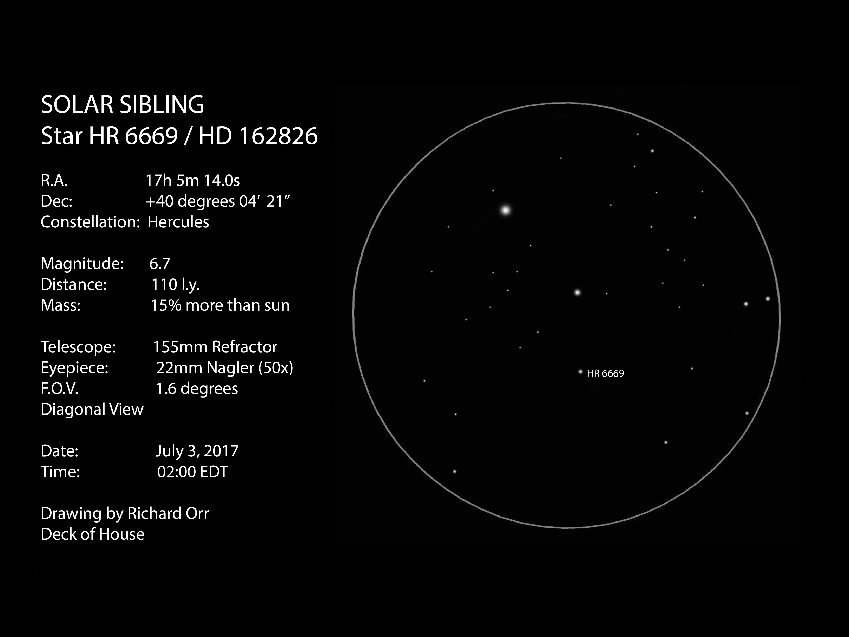
Richard Orr

Slide 9
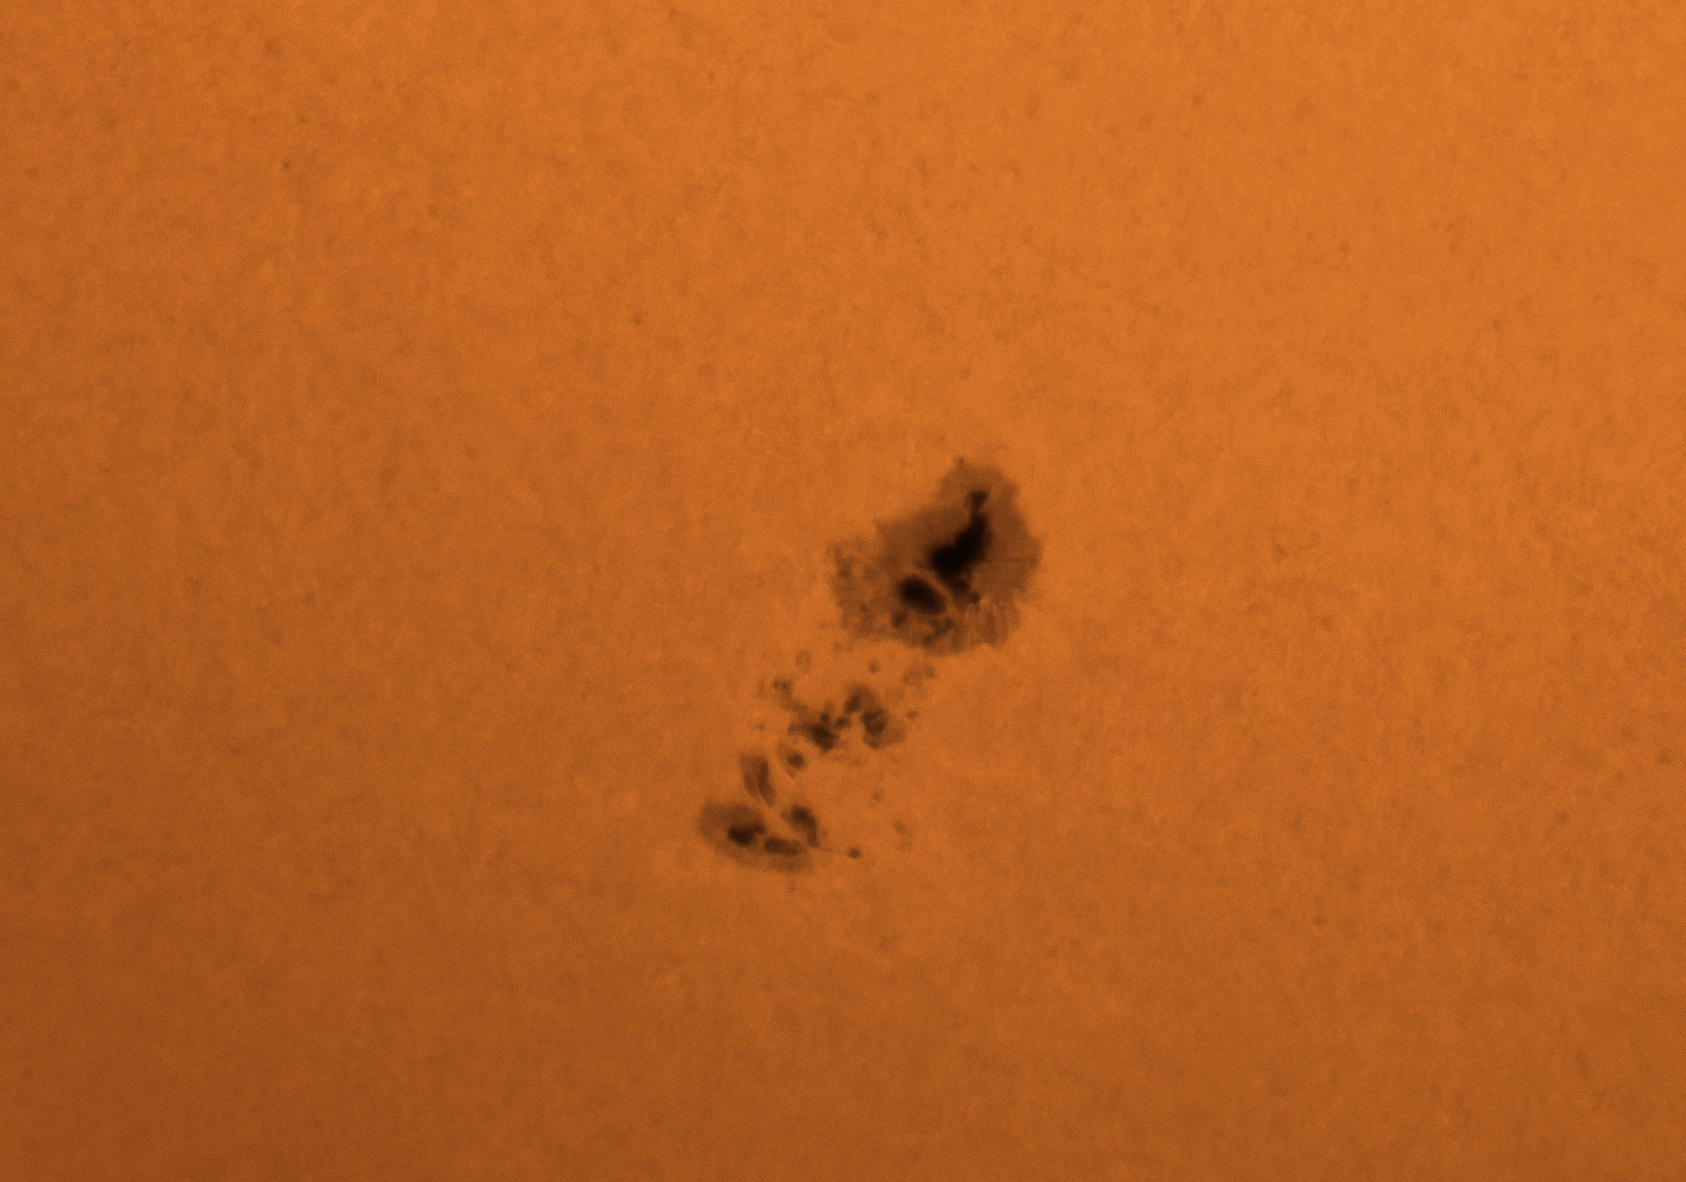
Richard Orr
Sun's Active Region (AR-2665) on July 8, 2017.
Photo taken with a 155mm refractor,
4x barlow and a Nikon D810 camera.

Slide 10
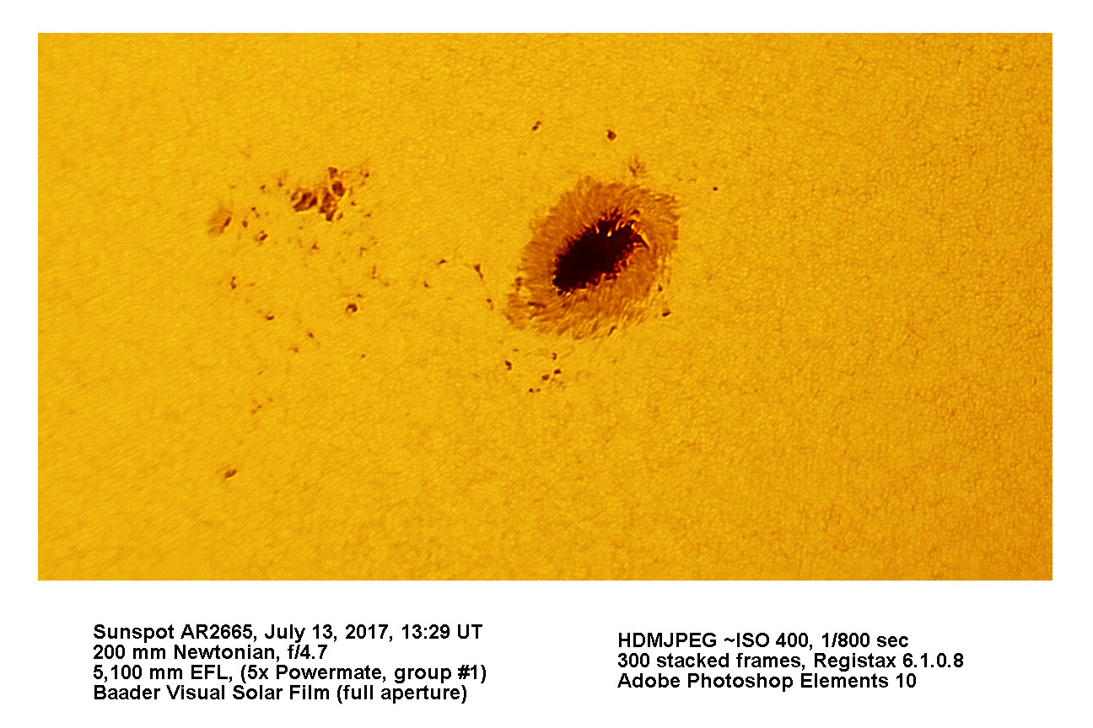
Gary Frischorn

Slide 11
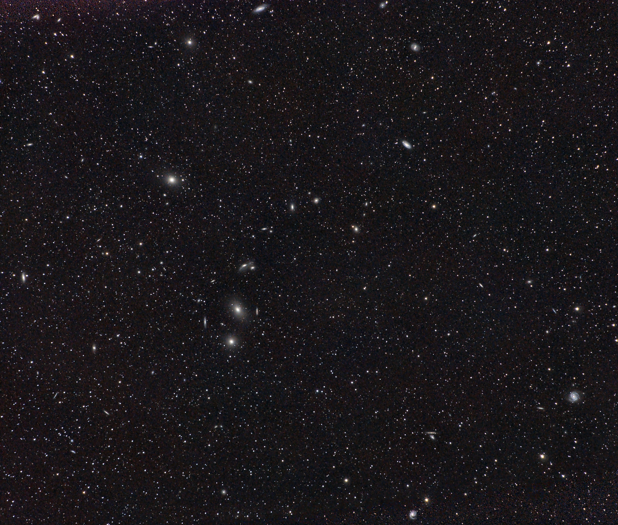
Victor Sanchez
Markarian’s Chain From Tanzania
Notes:
Markarian's Chain is a stretch of galaxies that forms part of the Virgo Cluster. It is called "chain" because, when viewed from Earth, the galaxies lie along a smoothly curved line. Charles Messier first discovered two of the galaxies, M84 and M86, in the year 1781. The other galaxies seen in the chain are first mentioned in John L. E. Dreyer's New General Catalogue, published in 1888.^{[1]} It was ultimately named after the Armenian astrophysicist, B. E. Markarian, who discovered their common motion in the early 1960s.^{[2]} Member galaxies include M84 (NGC 4374), M86 (NGC 4406), NGC 4477, NGC 4473, NGC 4461, NGC 4458, NGC 4438 and NGC 4435.
Victor also says, “I am working on a 3 panel mosaic of the full Scorpio constellation that I hope will be *really* good. Should have it ready for next month.”

Slide 12
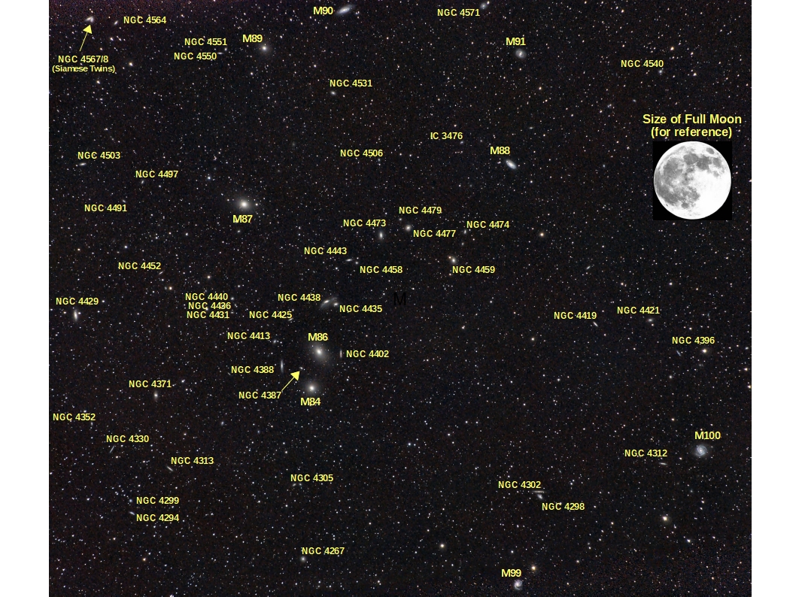

Slide 13
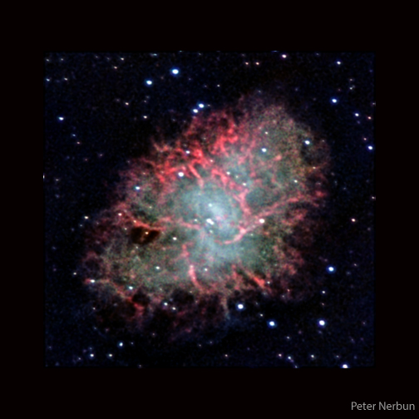
Peter Nerburn
Crab Nebula (M1)
Notes:
I captured this image with an 11 inch aperture SCT (a C11 SCT), an ATIK460EX monochrome main imaging camera, a Lodestar X2 guide camera, an F/6.3 focal reducer, an On-Axis Guider and a Starlight Instruments motorized focuser control system. I used Red, Green, Blue and H-alpha filters over a total integration time of 468 minutes (about 8 hours). I processed the data in Pixinsight where I enhanced data in the Red channel with Hydrogen-alpha channel data to create an enhanced Red channel image and then combined that enhanced Red channel image with Green and Blue channel images to yield an HA_R-G-B image. I captured the Flats with a light panel and cropped the original image to show fewer background stars so as to highlight the nebula itself.

Slide 14
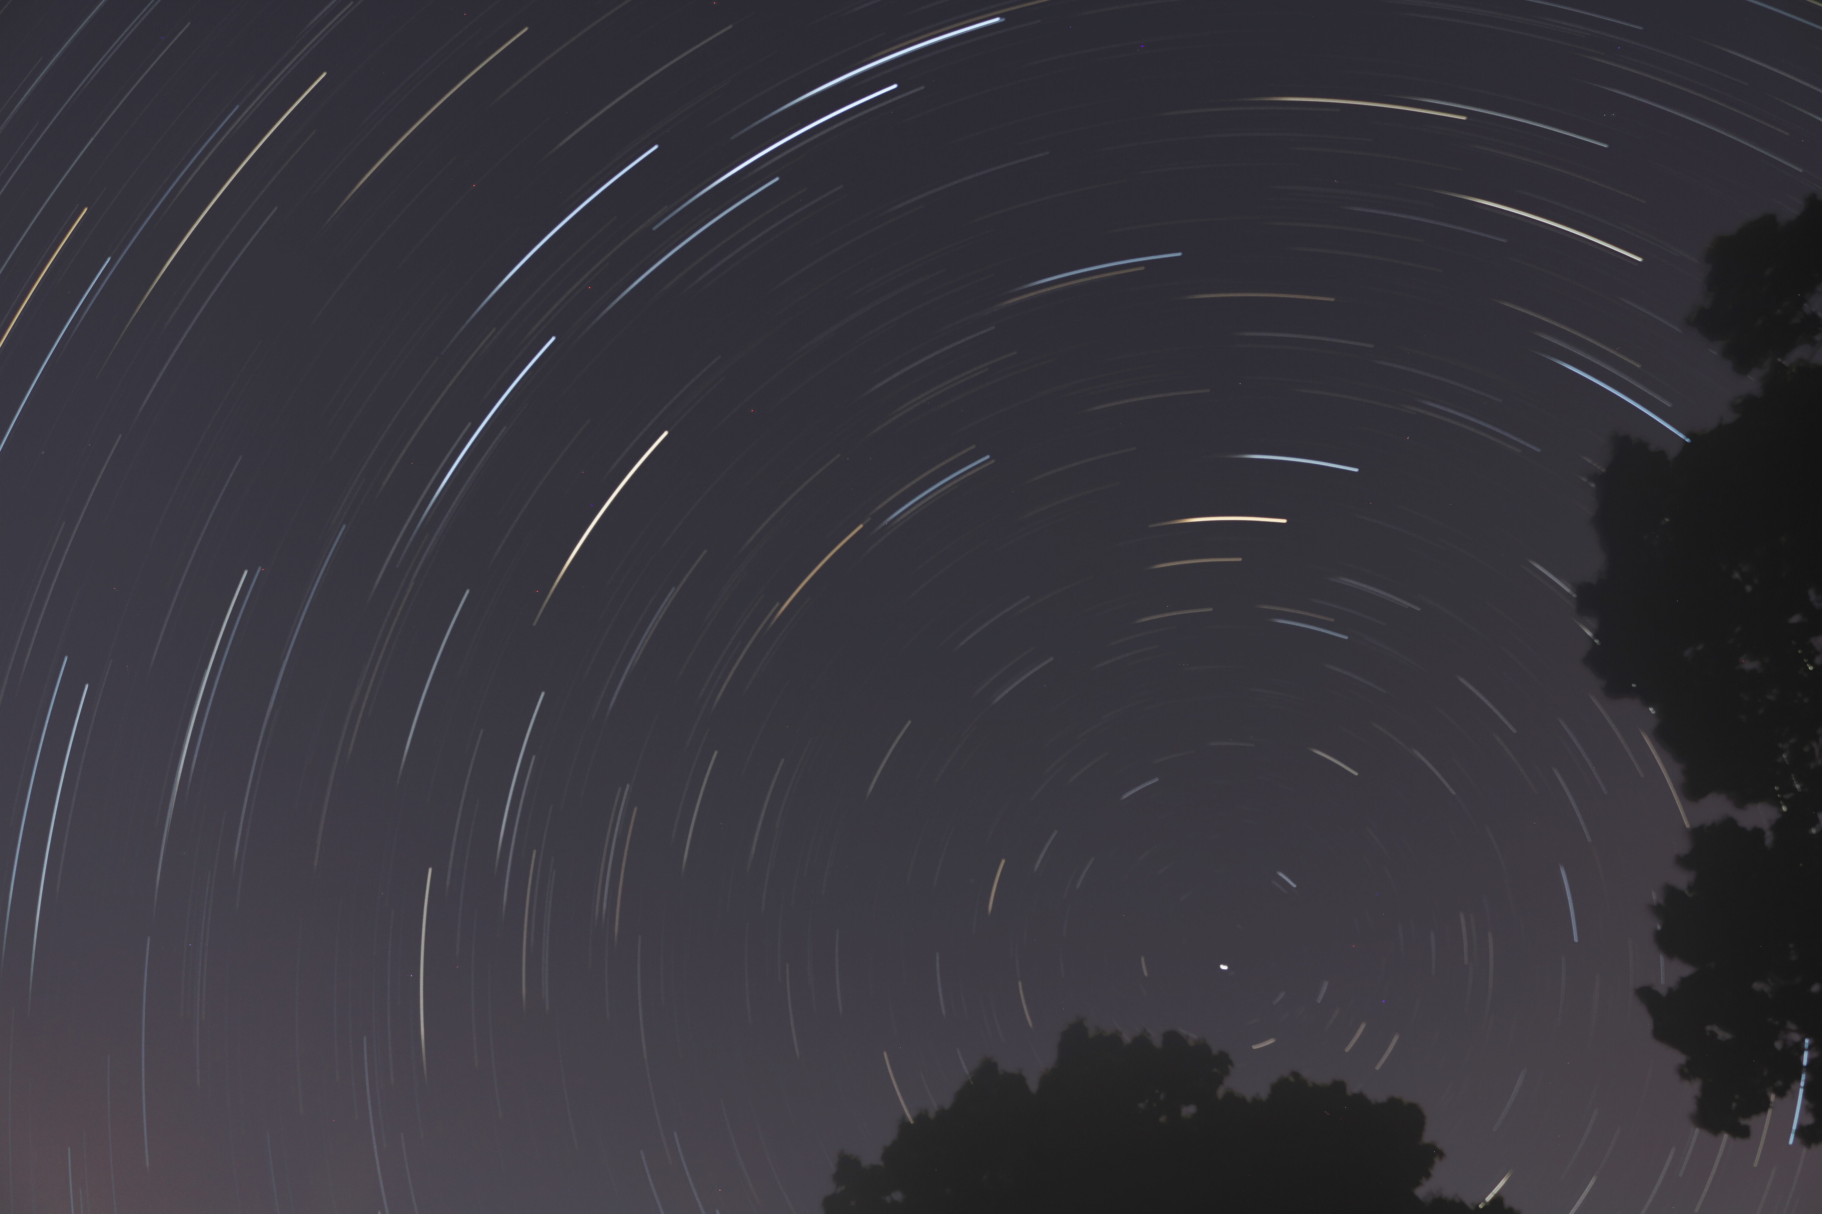
Gary Gilbert

Slide 15
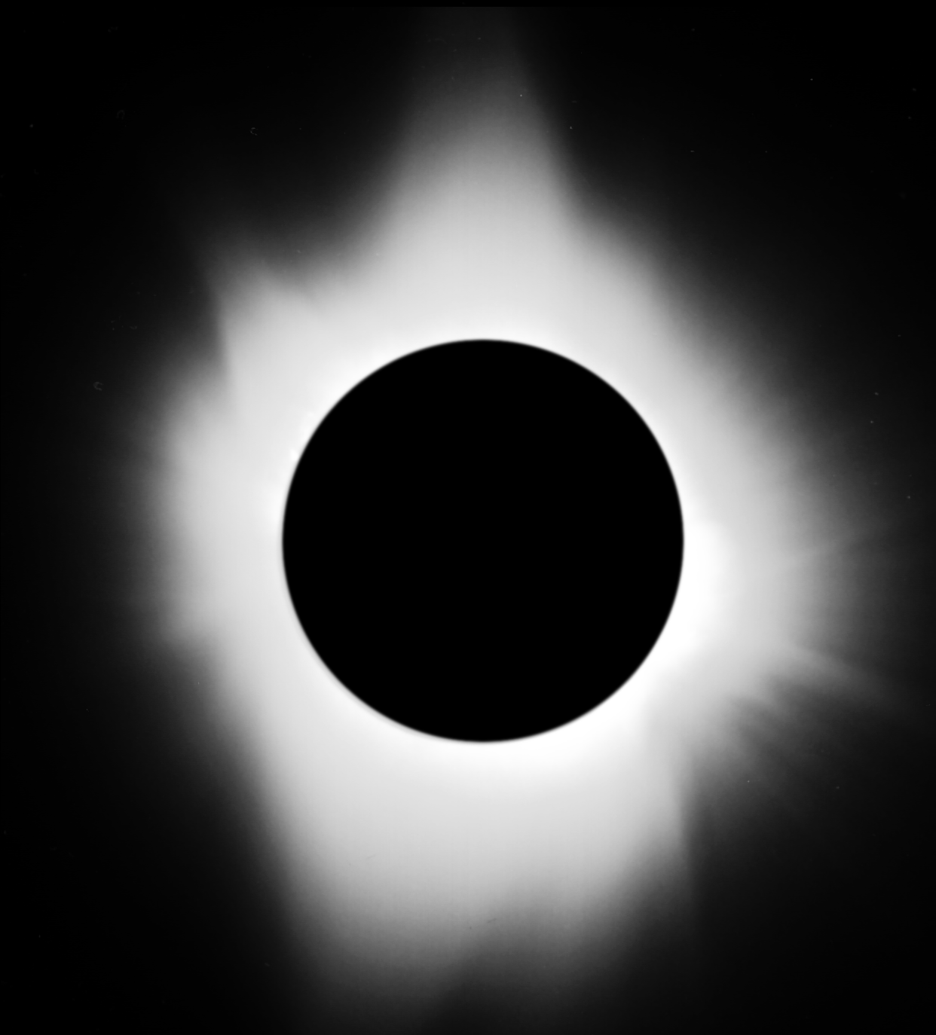
1991 Eclipse - Gene Handler
Notes:
Here's an image from the July 1991 total solar eclipse. It combines several images of varying exposures taken on film through a 500mm f/4 reflector on board a cruise ship in the Gulf of California.

Slide 16
Solar Eclipse
Aug 21st 2017

Slide 17
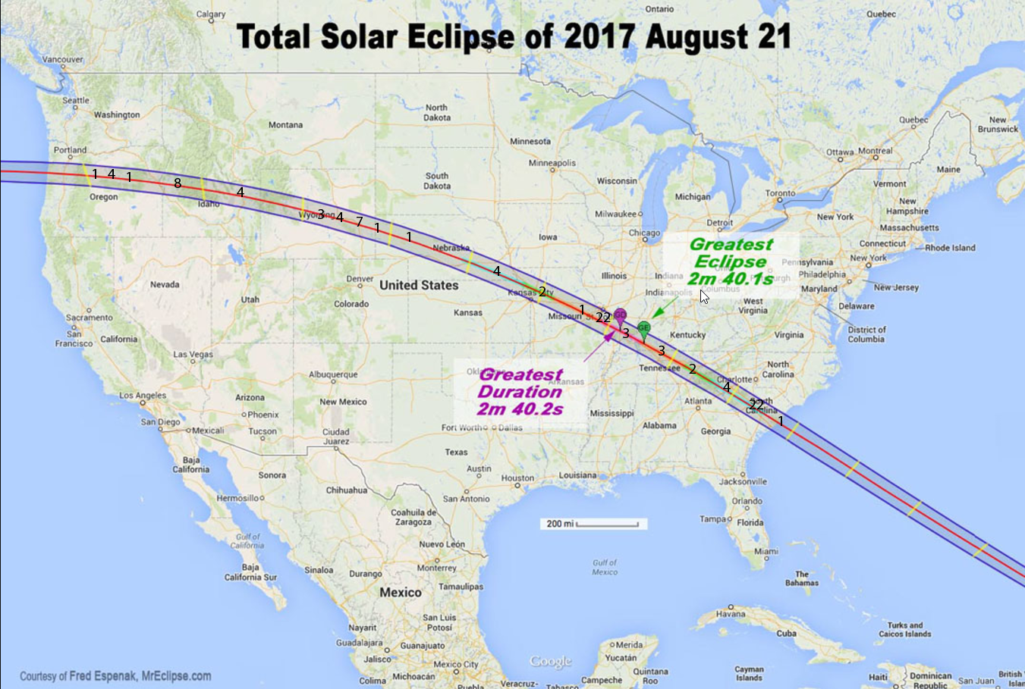

Slide 18
HAL Viewers In Totality
Most are willing to drive from their default areas in the totality zone to find a cloud-free location, if necessary.
I propose an App to help coordinate the effort for those in same general locations called “GroupMe”
      Group chat app for iOS, Android, and Windows phone.
              I have set up a group called HAL Eclipse in this app.
              If interested email me so I can send you the link to join the group.
        Feel free to install this app, and post to this group to test any time, starting now.
        Feel free to use to inquire about weather in totality or to share your experiences with each other during the event.

Slide 19
What are you Taking to Totality?
Solar glasses?
Solar binocs?
Solar telescopes?
Solar filtered cameras?
Sun Screen!
Camping?

Slide 20
Viewing Locally?
Currently HAL has no planned events
  Joel does have some solar glasses
Know of any organized events?
  Outside Macy’s at the Mall w/HCC
  Banneker Museum free w/registration
  Others?

Slide 21
Night Sky Summary
Sun now rises at 5:58am and sets at 8:30pm
Moon: ◐ August 14 |⚪July 23|◑ July 30|⚫ August 7
Planets: Saturn – Great view of open rings overhead
Jupiter – getting low, view immediately after sunset
Venus – Before sunrise only
Mars & Mercury pretty much out of sight.
Other: Perseids peak Aug 12th. Unfortunately, only 5 days after full moon and moon rises right about astronomical twilight. No scheduled HAL event.
Lots of deep sky objects overhead plus the ever popular Albireo

Slide 22
Thank You!
Next month’s meeting is on Thursday, August 17, 2017 at 7 PM
Guest Speaker: Dr Bindu Rani, NASA Post Doctoral Fellow at Goddard Space Flight Center
Talk Title: Wobbling jets in active super-massive black holes

